Slide 1
My Body Has Been Hacked!
A PowerPoint Presentation by Helen Chelan Johnson

Slide 2
What would you do?
Have you ever had to take your computer to the shop to get it fixed? It’s been hacked, and there’s a big possibility that someone has stolen all of personal your information. What now? You have to call the credit bureau and have your social security number flagged. It’s time that you take the necessary steps to make sure your identity stays safe. You’ll probably never put your personal information online again. Lesson learned, right?

Slide 3
But, wait…. What if your computer was you?
Your body has been hacked. It’s shutting down. Something has malfunctioned inside of you. We’re unsure of the current cause, but a few diagnostic scans should reveal it the problem shortly…
Eureka! We’ve found the problem. It’s looks like you have been infected by a virus. It’s a simple solution, though. We’ll just have to erase everything from your hard drive, and start fresh. Is there anything you’d like to save? It’s not guaranteed, but we’ll put our best efforts into recovering them before wiping the slate clean.
Wait… erase everything?! From my body?! Surly not. Something doesn’t seem right about that.
It doesn’t seem right because it isn’t right. The human body shouldn’t have anything in common with a computer.
……Should it?

Slide 4
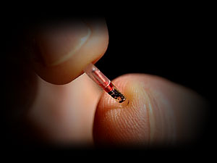
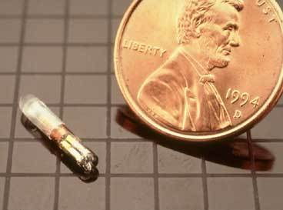
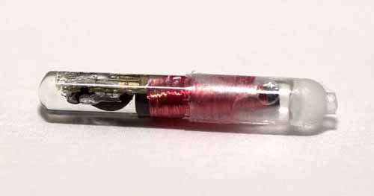
FDA Approves Computer Chips for Humans
A controversial new computer chip, made by VeriChip, was designed to be implanted into a human arm was approved by the FDA in December of last year. It was designed to speed up the process of getting vital patient information to doctors and hospitals. The chip is roughly the size of a single grain of rice and is inserted into the arm with the pinch of a syringe, a procedure that takes less than twenty minutes and leaves no stiches. The cost of the device is likely to be somewhere around $150-$200.

Slide 5
Where did the idea come from?
PositiveID Corporation announced today that it has received an order for it’s VeriChip™ microchip to be used for disaster preparedness and emergency management in Israel by an integration partner. The Company’s integration partner intends to provide the microchips to the Israel Defense Forces (IDF), the State of Israel’s military force.
Marc Poulshock, PositiveID’s Vice President of Business Development, said, “We believe there are many important applications for the VeriChip and our associated intellectual property including next-generation identification and bio-sensing capabilities. Our partner is looking to help healthcare organizations, militaries including the IDF, and governments with their disaster preparedness and emergency response needs.”

Slide 6
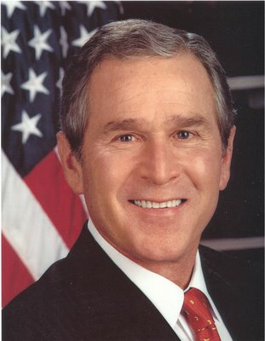
George W. Bush
President Bush had a ten year plan to get the majority of the US population implanted with microchips.
“The U.S. Department of Health and Human Services on Wednesday announced $139 million in grants to help make real President Bush’s push for electronic health records for most Americans within a decade.”
Medical records aren't stored on the chip its-self, but rather on a so called "secure" server.

Slide 7
Here's a bit of truth for you. There’s no such thing as a “secure" server. If it's physically connected to the internet then it's possible it can be hacked, period.
Just like with Sony and their violations of the consumer code that states a customers credit information should NEVER be stored on a server connected to the web. Instead customer information, credit card numbers and passwords, should be on a server that's NOT connected to the web except for when a customer makes a transaction. If Sony would have followed these laws they never would have lost people's credit information.
The other main concern is this chip does allow the person who has been chipped to be tracked at all times.
Good luck trying to hide if you ever needed to. Now, one could argue that if you don't do anything wrong there's no reason for you to care whether or not you can be tracked by satellite.
It’s not about that – it’s about privacy don’t want anyone to see where I am at every second of the day because I've been tagged like some cattle.

Slide 8
Sources
FDA approves computer chip for humans, www.msnbc.com
George W. Bush, Mark of the Beast, www.apfn.org
Micro chipping the Population, www.illuminati-news.com
The Truth about VeriChip, www.theverichip.com
PositiveID Corporation, www.positiveid.com

