Slide 1
The negative effects of technology
by: Jeffrey Miller

Slide 2
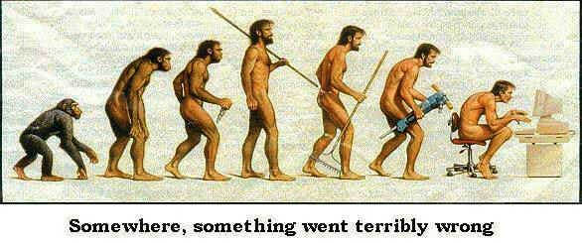
Technology has changed the world in numerous ways ranging from war, when the U.S. dropped the atomic bombs on Japan, or just getting a new iPhone that every one wants. No matter the reason why we want the technology, it has more negative effects on us than positive effects. The negatives are the loss of jobs, cell phones causing various forms of cancers, and war between countries.

Slide 3
Cell phones are a pretty great tool to have, but some researchers say, “we might die from jaw, ear and throat cancers in the coming 40 years.”

Slide 4
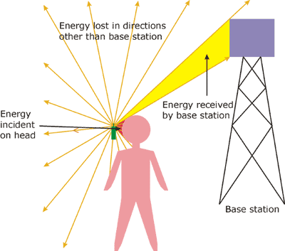
Cell-phones emit radio frequency energy that increase the risk of cancers.
According to national cancer institute, “ when people use a cell-phone for 50 minutes brain tissues on the same side of the head as the antenna metabolized more glucose that did tissues on opposite side of the brain.”
Cancer cells alter their metabolism in order to support their rapid growth.

Slide 5
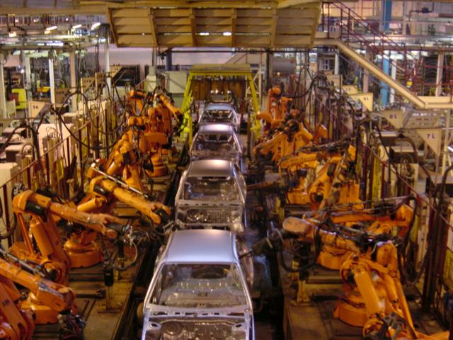
Companies are replacing human labor with machinery. Technology has unemployed many Americans that work in factories that produce steel and automobile. Even check out lines have become automated. David J. Hill said, “ 1 Million Robots To Replace 1 Million Human Jobs At Foxconn”. People are afraid that machines will take nearly all jobs.

Slide 6
Jobs that has been taken over by technology
Automobile workers
Factory workers
Farming
Cashiers

Slide 7
Without technology there might not be warfare because warfare and technology have been linked closely. Recently North Korea has began testing nuclear bombs. A senior U.S. official said, “ North Korea is in a mindset of war , but North Korea is not going to war.” In WW2 the U.S. stopped the war through technology using the atomic bombs. The negative effects of technology can lead to another World War.

Slide 8
Technology that came from war
Atomic bombs
Nuclear bombs
Laser guided bombs
RADAR and SONAR
Jet engines
Guns

Slide 9
Work cited
Dedoimedo.com, five thing that technology made worse. 13 Apr. 2011 Web. 22 Apr. 2013
Cancer.gov. cell phone and cancer risk 18 Jun 2012 web. 22 Apr. 2013
Ncbi.nlm.nlh.gov. national center for boitectnolngs information .Jul. 2010 web. 22 Apr. 2013
Garrett, major. CBSnews.com, 31 may 2012.web 22 Apr. 2013

