Slide 1
The Evils of Cloning
A PowerPoint presentation by D________ J_________

Slide 2
What is cloning?
Cloning present participle of clone Verb 1. Propagate (an organism or cell) as clone: “of hundreds of new plants cloned, the best ones selected.” 2. Make an identical copy of. Source: www.merriam-webster.com

Slide 3
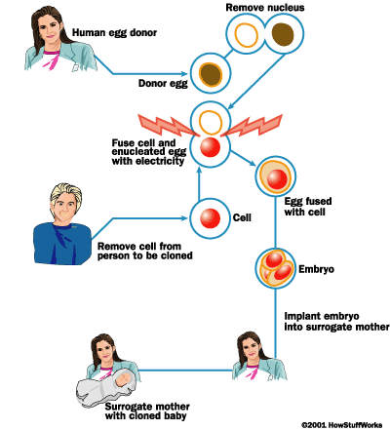
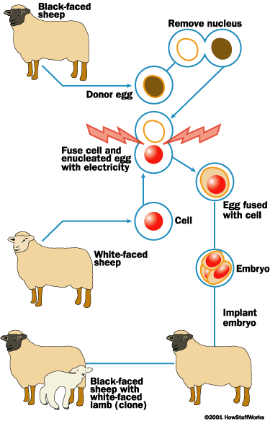
How does cloning work?

Slide 4
How would cloning change our world?
Cloning would change the evolution process as we know it. Cloning would change the future forever. If we allow cloning, people would be perfect. Technology would take over, but at the same time technology would freeze in time. We would not have the technology we have today if it wasn’t for imperfect people. Where would we be if it wasn’t for Einstein?

Slide 5
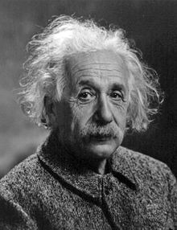
Why would we want imperfect humans?
Albert Einstein was an imperfect human being.
He lived his entire life not knowing something has simple as how to tie his shoes.
Albert Einstein wasn’t skilled in speech and language, the side of his brain controlling those functions was abnormally small.

Slide 6
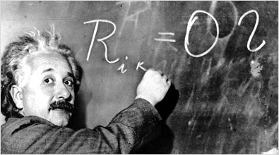
Where would we be without imperfect human beings?
Albert Einstein is the man responsible for many great accomplishments. Without his existence and imperfections, we wouldn’t know many beneficial things to today’s world and technology today.

Slide 7
Scientists are imperfect. They do make mistakes.
What if (or should I say when – everyone makes mistakes) they mess up? What will happen to the clone? Could scientists create a monster, rather than a miracle? Monsters do exist. Maybe not in the context that video games and horror movies lead you to believe – but all types of real monsters exist in this country. Can you imagine what kind of monsters our brilliant scientist could create? The American government is greedy – if cloning was legal, the Army would attempt to make a cloning Army within 24 hours. If you ever watched the upcoming television show “Beauty in the Beast” on CW, you’ll get an idea of where I am coming from – a real life beast, created by an accident. What would we do?

Slide 8
Is cloning unethical?
If you believe as I do, yes, cloning is simply unethical. I believe it’s wrong for man to create life because it’s against the natural order of life and God’s natural path for life and where it should go.
However, everyone is entitled to form their own opinion and believe how they want. Some people may say cloning is ethical because it doesn’t interfere with their personal beliefs.

Slide 9
Different Types of Cloning

Slide 10
Should cloning be illegal?
It’s believed that clones can think and feel just like what they were cloned from. Is it morally right to create a cloned human for the sole purpose of killing them and using their vital organs for survival of an actual human? If the cloned human can think and feel just like the actual human – isn’t that murder? How is that any better than abortion? Or than better than cold blooded murders who kill humans to sale this organs on the black market? No, it isn’t.

Slide 11
Where does cloning happen?
In some countries, cloning is actually legal.
Australia
European Union
United Kingdom

Slide 12
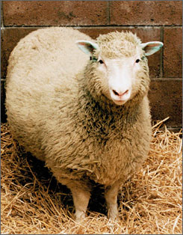
How has cloning changed our country thus far?
Meet Dollie!
She was a female domestic sheep, and the first mammal to be cloned from an adult somatic cell, using the process of nuclear transfer.

Slide 13
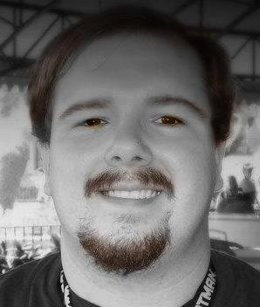
All jokes aside, do you really want two of these running around?

Slide 14
Just kidding, Mr. Combs!
Please don’t fail me.
☺

Slide 15
Sources
www.ornl.gov/hgmis/elsi/cloning.shtml
en.wikipedia.org/wiki/Cloning
learn.genetics.utah.edu/content/tech/cloning/
science.howstuffworks.com/environmental/life/genetic/cloning.htm
www.sciencedaily.com/news/plants_animals/cloning/

